Slide 1
What is Common Core, How Did It Get Here, and How It Affects Student Assessment
By Morna mcdermott, united opt out national

Slide 2
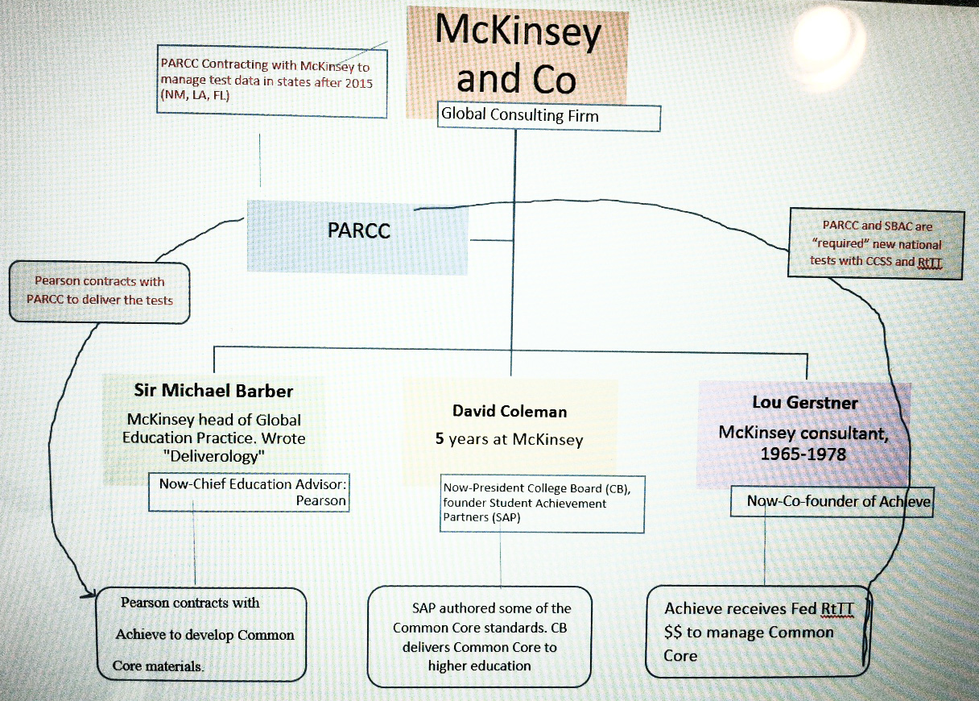
A brief history. To understand Common Core let’s examine how we got here first.

Slide 3
CCSS (2014): A standards-based system measures each student against the concrete standard. Curriculum, assessments, and professional development are aligned to the standards.
1983: Began with the publication of A Nation at Risk which claimed our schools were “failing” by international comparisons. Those findings have been widely debated, criticized and debunked.

Slide 4
National standards were also largely discussed by the U.S. Business Roundtable over the last few decades.
In 1990’s corporate CEOs made a ten-year commitment and adopted a state policy agenda to “improve student achievement that was undergirded by the fundamental belief that all children can and must learn at higher levels. “
The policy agenda included standards, assessments, accountability and technology.
Business Involvement in Education - A Nation at Risk, Partnerships With Business, Standards-Based Reform, Federal Education Policy - National, Leaders, Washington, and Students - StateUniversity.com http://education.stateuniversity.com/pages/1808/Business-Involvement-in-Education.html#ixzz3DXPvfP5b

Slide 5
The agenda to focus on standards and testing spans decades and is bi-partisan:
1994: The Goals 2000: Educate America Act (P.L. 103-227)" was signed into law on March 31,by President Bill Clinton. The Act provides resources to states and communities to ensure that all students reach their full potential.
2001: George Bush’s Public Law (P.L. 107-110), the No Child Left Behind Act.
2009: Race to the Top, abbreviated R2T, RTTT or RTT, is a $4.35 billion United States Department of Education contest created to spur innovation and reforms in state and local district K-12 education.

Slide 6
2012: The Council on Foreign Relations executed a paper stating that a poor performing students/schools are a “threat to national security.”
http://www.cfr.org/united-states/us-education-reform-national-security/p27618
They authors advocate for a set of national standards, national assessments … and refers to students as “human capital.”

Slide 7
I’m struck by something…are you?
Nation at Risk was written 30 years ago. That means that the people 30 years later- writing the Council on Foreign Relations report -were students in 1983, and thus the generation who themselves were considered to be placing our nation at risk.

Slide 8
So who initiated Common Core?
The initial motivation for the development of the Common Core State Standards was part of the American Diploma Project (ADP) developed by Achieve in 2005 which was created in 1996 by the nation’s governors and corporate leaders. http://www.scribd.com/fullscreen/48103823?access_key=key-2e50eyyjxst2rujxfmzv&allow_share=true&escape=false&view_mode=scroll

Slide 9
Three corporate executives crafted the idea for CCSS:
David Coleman (who founded Students Achievement Partners, and now president of College Board), Lou Gerstner (former IBM top exec and co founder of Achieve) and Gene Wilhoit (Director of the Chief Council of State School Officers- a non profit organization of public officials).
In order to fund their national standards project they asked for and received hundreds of millions of dollars from Bill Gates to promote, develop, advertise and implement the project.

Slide 10
By the way:
David Coleman, Lou Gerstner, and CEO of Pearson, Sir Michael Barber, all worked for McKinsey and Co-the world’s largest global consulting firm.
Their mantra for global human services management and marketing is: BIG DATA
http://www.mckinsey.com/insights/business_technology/big_data_the_next_frontier_for_innovation

Slide 11
OK. So the push for national standards wasn’t initiated by educators. It was initiated by businessmen and politicians.
But…surely the Common Core Standards were written by educators, right?
One would assume they’d be written by developmental specialists, content area specialists, K12 educators and university professors.
Right?

Slide 12



Actually… they were written by people from testing companies and non-profit executives.
Thirty individuals who wrote the standards work for one of five entities: Achieve, College Board, ACT, America’s Choice (a subsidiary of Pearson), and/or Student Achievement Partners.

Slide 13
OK… So the standards written for K12 children were not written by child development experts or educators.
But are they any good?
The standards claim to be “internationally benchmarked” and promise to make students ready “for college and career.” How do they know this?
Given the vast expanse of this program, its effects on children, and the associated financial burden, surely they tested this out first …right?

Slide 14
Well…not really.
The standards were never tested, studied, or “tried” anywhere to study their effectiveness before enforcing their adoption in forty-four states (the number is down now that many states have rejected their adoption).
So the standards have forced the total redesign of education for millions of American school children…with no evidence that the standards can or will deliver on their claims,

Slide 15

But is it state-led?
Or federally created?
Is it a pillow? Or a pet? It’s a pillow pet!

Slide 16
While the creators insist it’s “state-led” standards, we must consider the following.
One-- the standards are copyrighted.
The standards are copyrighted by NGA Center for Best Practices (NGA Center) and the Council of Chief State School Officers(CCSSO), which controls use of and licenses the standards.
The NGA Center and CCSSO do this by offering a license to State Departments of Education which use the standards.
However, two conditions apply: the use of the standards must be "in support" of the standards, and the waiver only applies if the state has adopted the standards "in whole". In other words, they cannot be changed (or adjusted) according to the individual needs of students).

Slide 17
Two—
In a report of U.S DOE contracts from 2011, one such contract was granted to Chief Council of State School Officers for “ADMINISTRATIVE DATA IMPROVEMENT - CONTRACT TO DEVELOP DATA STANDARDS FOR PREK-12 EDUCATION AND TO PROMOTE THEIR ADOPTION BY STATE EDUCATION AGENCIES (SEAS)” at a cost of $612,497.00.

Slide 18

Well…do teachers and parents like it?
It’s hard to tell….-

Slide 19
The American Federation of Teachers (AFT) leadership accepted one millions dollars a year for an innovation grant from the Bill and Melinda Gates Foundation. (It has declined this partnership beginning in 2014).
The National PTA received $1 million grant from Bill and Melinda Gates Foundation to engage parents in four states in support of the Common Core.
Do you publicly reject the project of your benefactor?

Slide 20
But…. the media would certainly be exposing this, right?
“Gates-backed think tanks turn out media fact sheets and newspaper opinion pieces. Magazines and scientific journals get Gates money to publish research and articles. Experts coached in Gates-funded programs write columns that appear in media outlets from The New York Times to The Huffington Post, while digital portals blur the line between journalism and spin.”
http://articles.mercola.com/sites/articles/archive/2012/07/31/bill-gates-corporate-profit-vs-humanity.aspx
Even NPR receives major funding from the Bill and Melinda Gates Foundation.

Slide 21
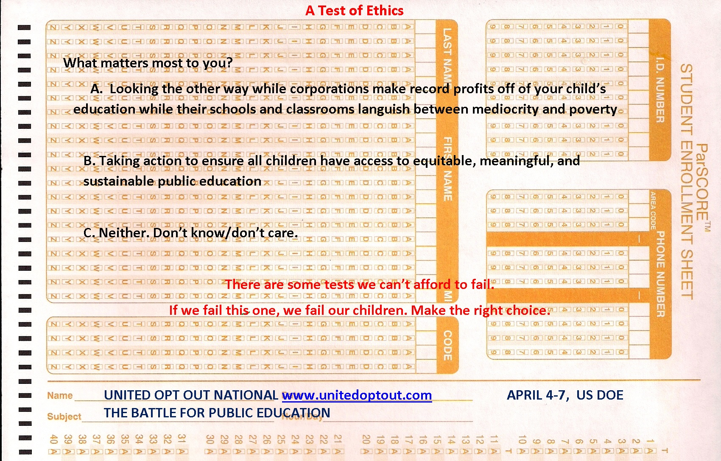
How does one “measure” success of standards?
Through nationalized standardized
assessments.

Slide 22

Achieve was selected to manage PARCC which was awarded to Race to the Top assessment funds to provide new assessments attached to CCSS.

Slide 23
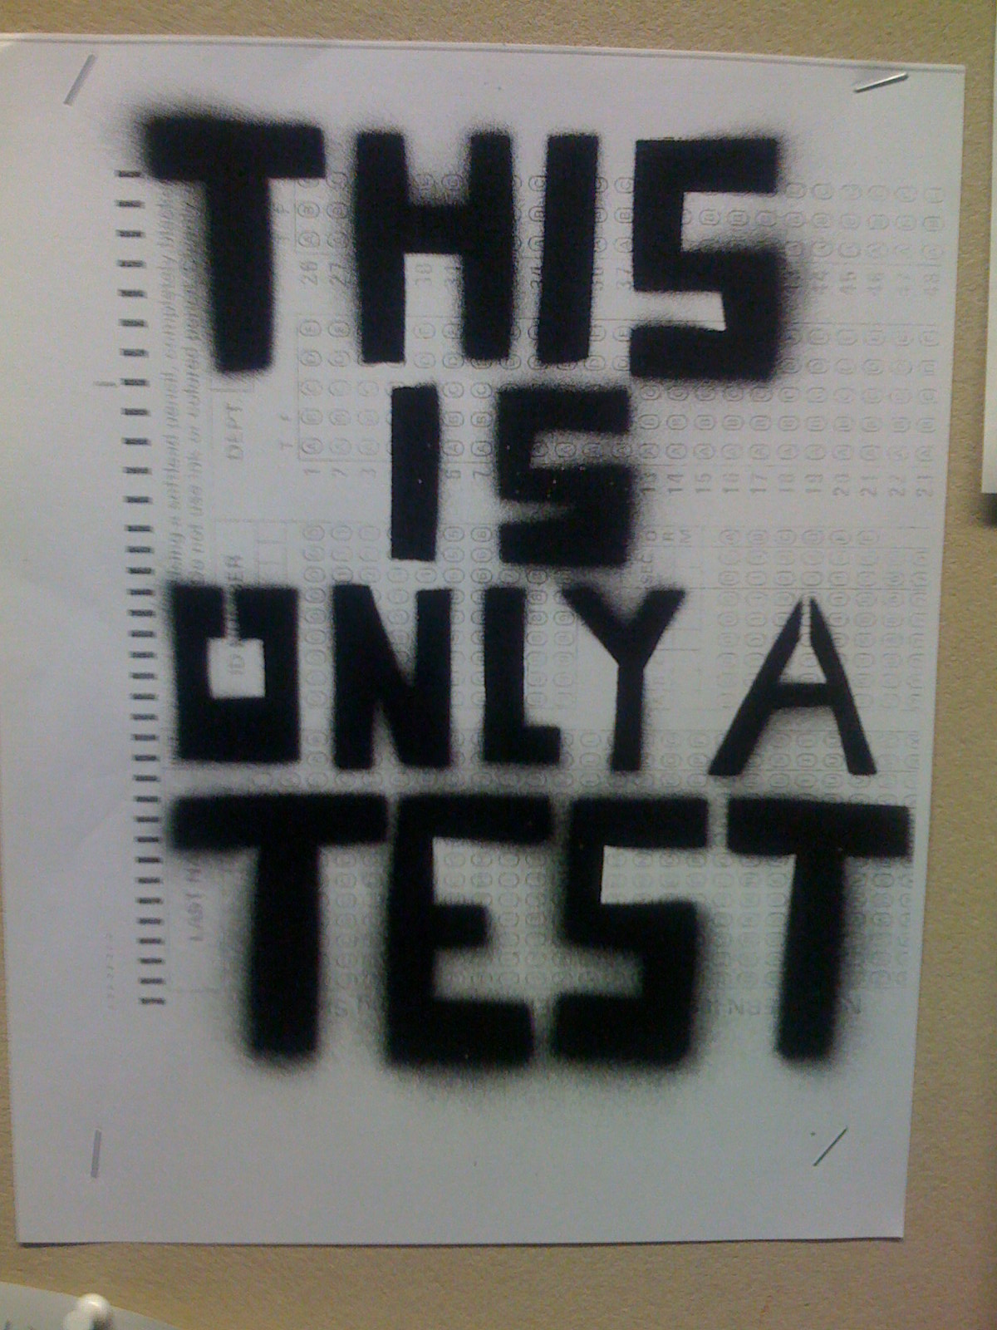
Let’s pause and examine the history of
standardized testing.

Slide 24

In 1937 a new national testing agency was created to operate all the leading standardized educational tests.
ETS was founded and used by the US Military for the selection of officers and then used in high schools around the country after that.

Slide 25
Standardized testing emerged at the turn of the century as part of the Eugenics movement.
It is a social philosophy advocating the improvement of human genetic traits through the promotion of higher reproduction of people with desired traits (positive eugenics), and reduced reproduction of people with less-desired or undesired traits (negative eugenics).

Slide 26
Carl C. Brigham, the father of the SAT was an enthusiastic member of the eugenics movement. Brigham later worked on the Army Alpha Test, an intelligence test given to millions of recruits during World War I.
In 1923, he wrote A Study of American Intelligence, which analyzed the findings of the Alpha Test by race (later became the SATs). Its conclusion was that American education was declining and "will proceed with an accelerating rate as the racial mixture becomes more and more extensive."

Slide 27
Study after study for decades have documented the bias of race, culture, gender and social class that skew the validity of these tests to measure actual student learning (or potential).
According to Donald Orlich, "Given the widespread use of tests to sort and/or classify students, the socioeconomic, social class and ethnicity status of students needs to be analyzed for apparent test bias by the educational com­munity, policy-makers and those who work in the social justice arena," he said. "Further, all those working with youth need to be aware of providing 'social capital' to all.“
http://researchnews.wsu.edu/society/169.html

Slide 28
Back to CCSS:
In tandem with the new standards, two consortia emerged to contract with US Dept of Education to deliver new assessments: PARCC and SBAC.
PARCC partnered with Pearson to develop and evaluate the tests.

Slide 29
So… if these tests are indeed faulty at best….who would want to use these tests to evaluate students?

Slide 30
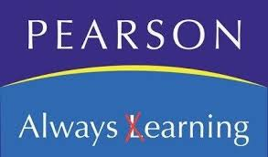
Pearson received a 12 million dollar contract from the U.S. Dept of Education in 2011 to “PREPARE AND PACKAGE ALL ASSESSMENT AND AUXILIARY MATERIALS; DISTRIBUTES ASSESSMENT BOOKLETS AND MATERIALS TO THE TEST ADMINISTRATORS FOR EACH SCHOOL; RECEIVES THE MATERIALS FROM THE SCHOOLS; WITH ID AND DAR CONTRACTOR DEVELOPS SCORING TRAINING MATERIALS; AND SCORES ALL ASSESSMENTS.”

Slide 31
In the last decade, the federal government has handed states more than $600 million to help them create these databases. The idea, says Stephen Balkam, head of the Family Online Safety Institute, is that “if we could keep track of our kids from kindergarten to 12th grade we'd have a much greater handle on what's working, what's not working, what needs to be added to the curriculum.”
Sales of educational technology software for kids in kindergarten through high school reached nearly $8 billion last year, according to the Software and Information Industry Association.
http://www.marketplace.org/topics/education/learningcurve/day-life-data-mined-kid#.VBrjmcTZ-kA.facebook

Slide 32
According to a paper written by the Fordham Institute (2010) called How Will Common Core Initiative Impact the Testing Industry), the demands of NCLB cut testing profit margins for testing companies.
The creation of the PARCC and SBAC consortia eliminate the need for every state to “create its own tests and thus cut down on the production costs” that are aligned to the common core.

Slide 33
So let’s recap:
A set of untried and unproven education standards written by testing companies and corporate executives has been launched wholesale across nearly every public school in the nation, and profits to corporations selling standards-related materials are sky rocketing. The measure of student success of these standards will now be determined by invalid and unreliable (and enormously expensive, time consuming) nationalized standardized tests whose roots go back to a movement that perpetuates racial superiority through “scientific evidence.” These tests are now taken on computers (remember Bill Gates who funded this whole thing?) where testing and education technology companies will now have access to 400 points of private student data which they can use in any way they please.

