Slide 1
Charter Schools in 20 minutes
Or, the 7 Minute Hamlet (Tom Stoppard)

Slide 2
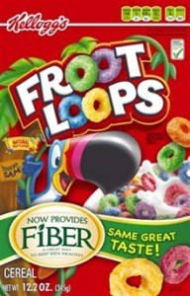
Most people are aware of the difference
Between advertising and truth.
The box says “part of a nutritious
breakfast”. But is that true?
How do we know when we are being sold something?
How are charter schools “selling out” public education in the same way?

Slide 3

So … let’s examine charter schools framing the discussion by context and narrative

Slide 4

What is a charter school?
A charter school is a school that receives public funding but operates independently (privately managed/owned) of the established public school system in which it is located.

Slide 5
The 1960’s Supreme Court decision -if you create a new school district and it increases segregation, it violates the Constitution.
Charter schools, depending on the state, are often considered independent:
-creating new schools,
new school organizations,
-that are even more segregated than the existing ones
-and not doing really anything to try to make sure that doesn’t happen and that students who make these kinds of choices have diversity and all the values that it gives you in terms of academic preparation and preparation for life.

Slide 6
Historical CONTEXT: History time line: http://www.educationevolving.org/system/chartering/history-and-origins-of-chartering
What else is going on during the 1950’s, 1960’s and 1970’s in public education?

Slide 7
Two years before a federal court set a final desegregation deadline for fall 1959, local newspaper publisher J. Barrye Wall shared white county leaders’ strategy of resistance with Congressman Watkins Abbitt: “We are working [on] a scheme in which we will abandon public schools, sell the buildings to our corporation, reopen as privately operated schools with tuition grants from [Virginia] and P.E. county as the basic financial program,” he wrote. “Those wishing to go to integrated schools can take their tuition grants and operate their own schools. To hell with 'em.” http://www.alternet.org/education/racist-history-charter-school-movement

Slide 8
What else?
Rewind to 1980—when Milton Friedman, the high priest of laissez-faire economics, partnered with PBS to produce a ten-part television series called Free to Choose. He devoted one episode to the idea of school vouchers, a plan to allow families what amounted to publicly funded scholarships so their children could leave public schools and attend private ones.

Slide 9
Financial CONTEXT: Privatization and a market-driven education system. The charter school movement is surging in popularity among hedge fund investors, where there are plenty of investment opportunities and tax breaks in a safe and quickly growing sector.
http://www.lisc.org/docs/events/031015_bonds_blackboards_agenda.pdf

Slide 10
There are strong and overt ties between Wall Street, free market enterprise and the growth of the charter school agenda
“Many hedge funders and financiers contribute to state-level groups or to individual schools. Billionaire Carl Icahn founded the Bronx charter school named for him. Spencer Robertson, son of billionaire Julian Robertson, started PAVE Academy in Red Hook, NY.
See Muckety:
http://news.muckety.com/2013/05/05/wall-street-charter-schools/42601

Slide 11

Narrative CONTEXT:
“choice” “status quo” “monopoly” “not defined by zip code”
https://schoolchoiceweek.com/

Slide 12
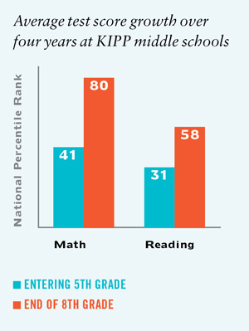

Slide 13
ALEC is “born”: A corporate/legislative “partnership” which meets behind closed doors to craft state level legislation that serves corporate interests in the name of the “free market” –one of their main goals has been the privatization of public education. http://www.alec.org/alec-about/ ALEC was founded in 1973 in Chicago as the "Conservative Caucus of State Legislators"

Slide 14
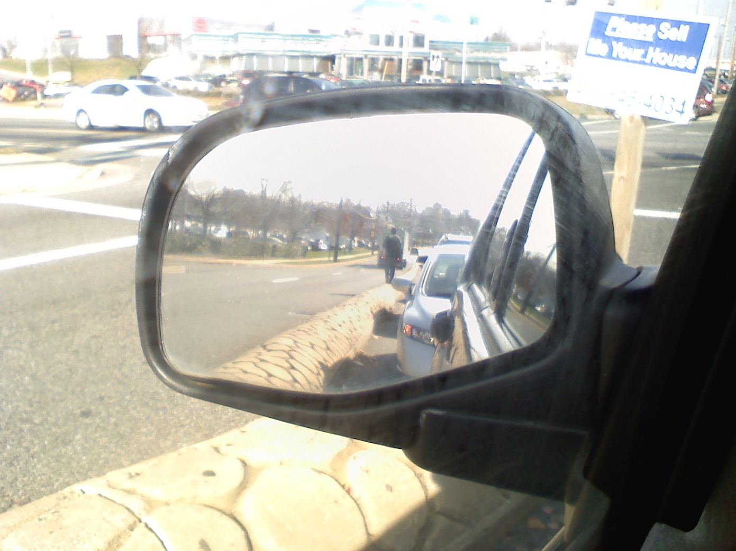
What does the research show?

Slide 15
A Stanford study (2009) found that 17 percent of charter schools reported academic gains that were significantly better than traditional public schools, while 37 percent of charter schools showed gains that were worse than their traditional public school counterparts, with 46 percent of charter schools demonstrating no significant difference.

Slide 16

Profits
“They are attracting yield-hungry investors who have pushed into riskier debt in search of better returns amid low interest rates.”
http://www.wsj.com/articles/charter-schools-find-smarter-way-to-borrow-1419820840

Slide 17
High Attrition Rates
KIPP charter middle schools enroll a significantly higher proportion of African-American students than the local school districts they draw from, but 40 percent of the black males they enroll leave between grades 6 and 8, says a new nationwide study by researchers at Western Michigan University.

Slide 18
Fraud
One report shows that over $100 million has been lost to fraud and abuse in the charter industry, because there is virtually no proactive oversight system in place to thwart unscrupulous or incompetent charter operators before they cheat the public. The actual amount of fraud and abuse the report uncovered totaled $136 million, and that was just in the 15 states they studied. In just 15 of the 42 states that have charter schools, charter operators have used school funds illegally to buy personal luxuries for themselves, support their other businesses, and more. http://integrityineducation.org/charter-fraud/

Slide 19
Zero Tolerance
Charter schools also lead their traditional counterparts in a more disturbing trend: the number of students who are suspended or expelled each year. Education Department statistics indicate minority students—specifically African American boys and girls—are several times more likely to face harsh punishments, such as out-of-school suspensions.

Slide 20
Segregation
“Choice”? A 2010 report by the UCLA-based Civil Rights Project, "Choice without Equity: Charter School Segregation and the Need for Civil Rights Standards," uncovers some troublesome facts in this regard. “While segregation for blacks among all public schools has been increasing for nearly two decades, black students in charter schools are far more likely than their traditional public school counterparts to be educated in intensely segregated settings. At the national level, 70 percent of black charter school students attend intensely segregated minority charter schools (which enroll 90-100 percent of students from under-represented minority backgrounds), or twice as many as the share of intensely segregated black students in traditional public schools.”

Slide 21
According the KKK’s own website:
Parents have been given a choice as to where to send their children and without government interference, many have selected schools with a student population that reflects the race of those children. In addition, many of these schools satisfy the children’s longing to identify with their racial history by incorporating cultural studies relating to their ethnicity. There is nothing wrong with this, yet some think it is terrible. In fact, the majority of people prefer to be around others who are like them. Even those who enjoy international travel and experiencing other cultures still, for the most part, live the rest of their life among those of similar racial background. Why does this make some social engineers so angry? It is only natural. Each race should have the right to determine their own affairs .

